Slide 1


UNIT 7: On top of the world
Superheroes

Slide 2
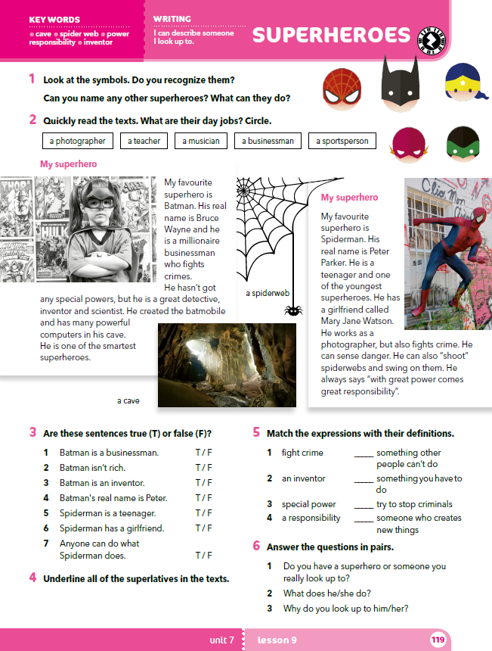
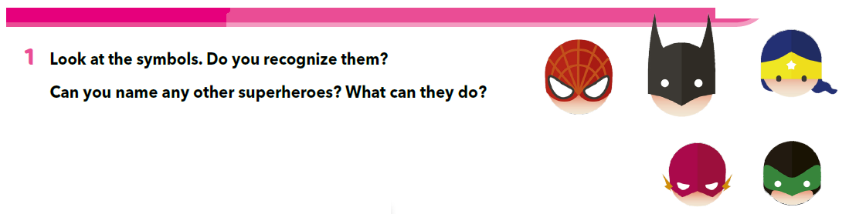
Can you recognize the people in Task 1?
Do you know any other superheroes?
Why are they special?
What can they do?

Slide 3
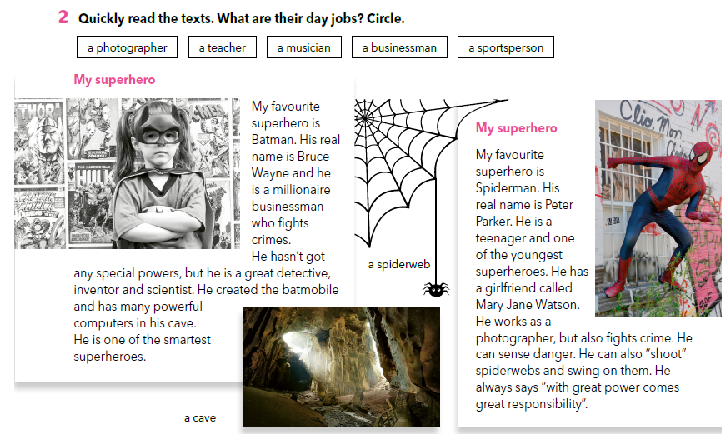
Do you know what other superheroes do?

Slide 4
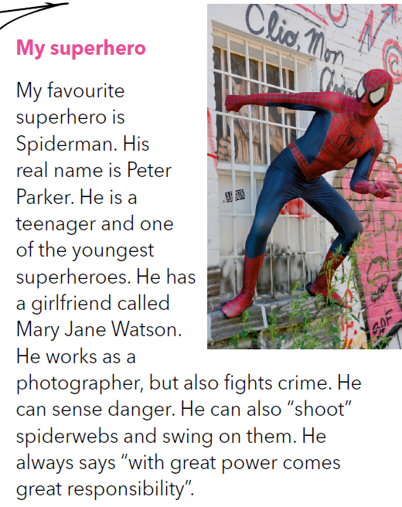
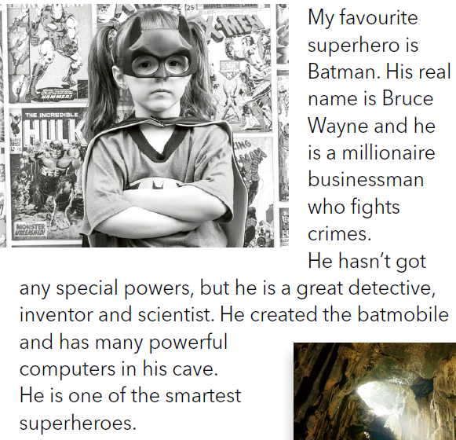
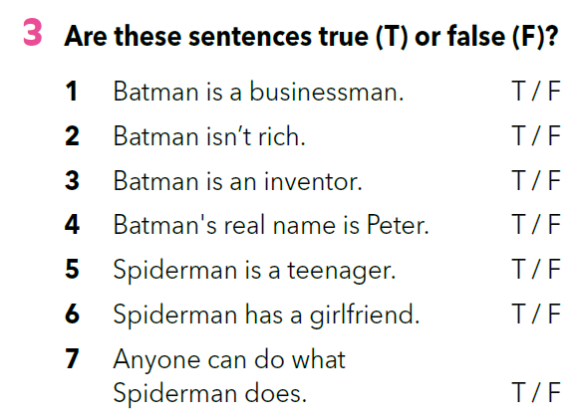

Slide 5
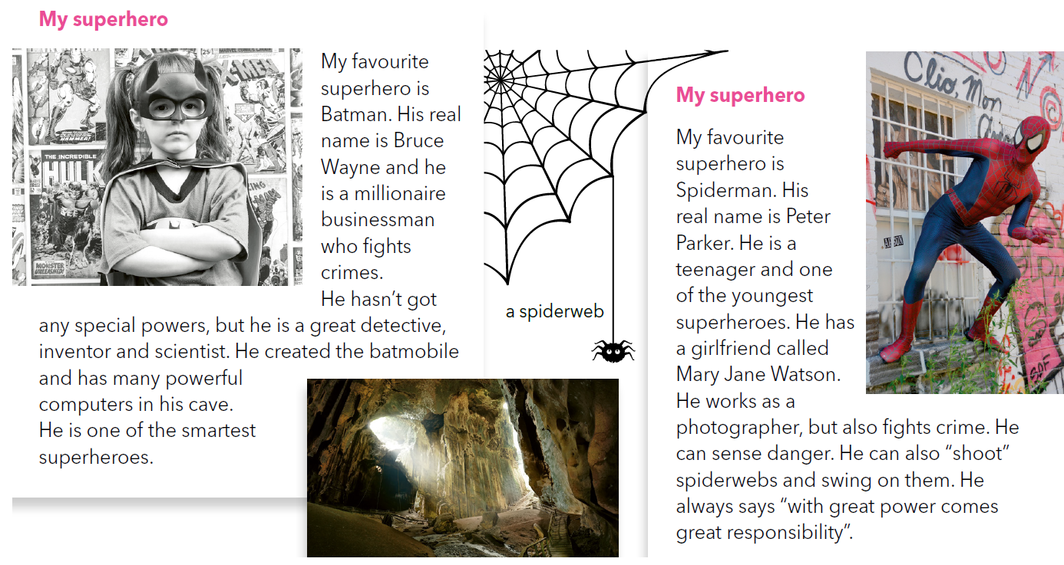
Copy the superlatives in your notebook.
Use the superlatives from the text and write the sentences on your own (about superheroes, animals or your school).

Slide 6
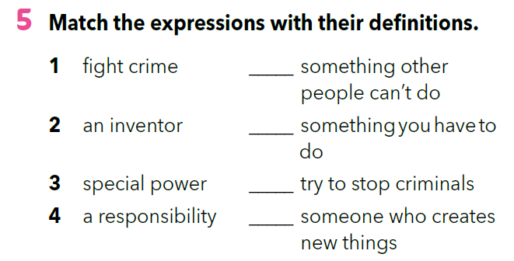
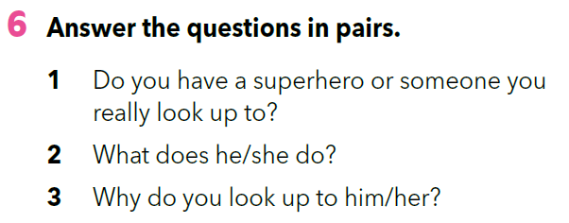
3
4
1
2

Slide 7
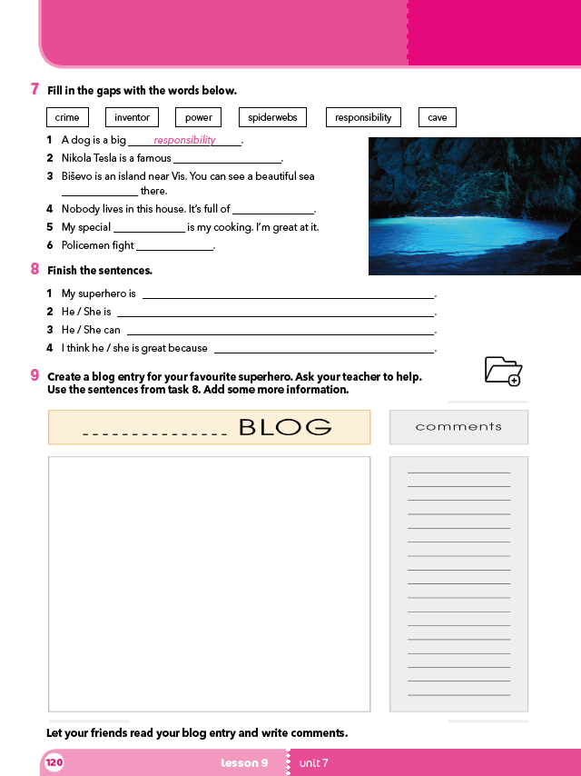
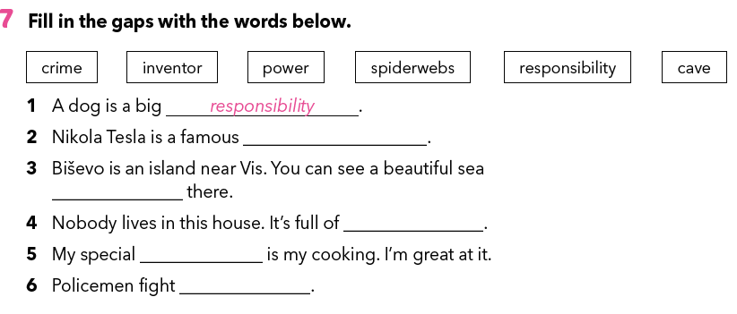
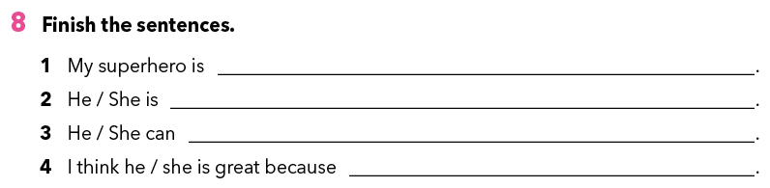
Which texts are these words from?
Can you find a sentences with the word ”crime” in it?
inventor
cave
spiderwebs
power
crime
How much do you remember about superheroes. Do the quiz.
https://wordwall.net/play/261/687/730

Slide 8
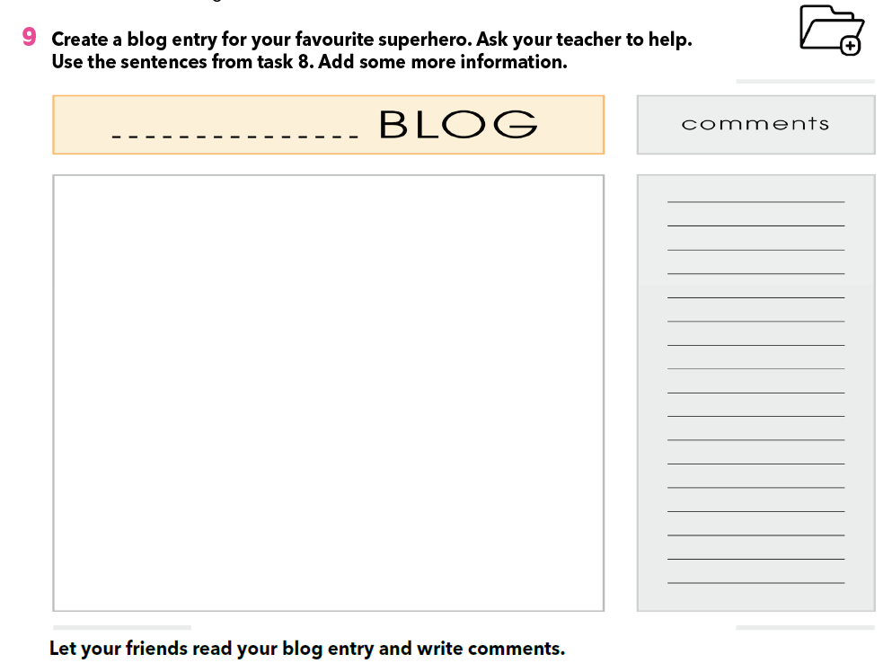
Napiši kratak tekst (do 80 riječi) o nekom svom superheroju. Možeš se poslužiti rečenicama iz 8. zadatka, no trebaš dodati barem dvije nove informacije i jednu fotografiju ili ilustraciju.
Prilikom pisanja teksta vodi računa o check-listi koju ste osmislili zajedno s vašim učiteljem.
U parovima zamijenite bilježnice i jedan drugome, uz pomoć check-liste, napišite što ste dobro napravili, a što bi trebali popraviti.
Ispravi pogreške u svom tekstu prema uputama prijatelja i prepiši blog u udžbenik.
Do you know what a ”blog” is?
Blog is a short form of the term „weblog” (web + log, internetski dnevnik)
Do you know anyone who writes a blog?

Slide 9

LET’S REVISE!
Click on the following links and complete the tasks.
https://wordwall.net/play/261/682/951
https://wordwall.net/play/261/684/125
LEARN MORE
https://www.e-sfera.hr/dodatni-digitalni-sadrzaji/901d4dd1-2f14-47aa-b6b8-c027ea8fcfb9/
Female superheroes

